Slide 1
Radiation

Slide 2
By the end of this Smart Lesson you will be able to:
Describe how radiation transfers heat.
Identify factors that affect the absorption of heat by radiation.

Slide 3


Slide 4
Every object radiates heat.
This heat is transmitted as invisible waves that move at the speed of light!
Radiation transfers heat by waves, unlike conduction and convection which transfer heat through particles. This means that it can travel through the vacuum of space!
In physics terms, we say that radiation does not need to travel through a medium to transfer heat.

Slide 5

Every object radiates heat, even if we can't feel it. You are radiating heat right now!
Hotter objects radiate more heat.
Some examples of objects which radiate heat are the Sun, a fire, your pet cat... the list goes on and on!

Slide 6

All objects emit radiation, but radiation can also be absorbed.
Different objects can absorb different amounts of radiation. The amount of radiation that can be absorbed depends on the material and colour of the object.

Slide 7
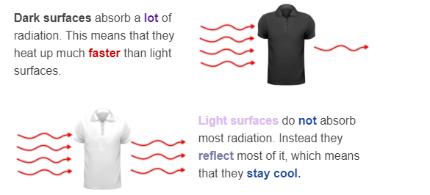
How light or dark a surface is affects how much radiation is absorbed.

Slide 8
What about clear objects that have no colour?
Clear objects, like glass, do not reflect or absorb heat radiation. Instead they transmit the radiation. This means that radiation passes through the object.
This is how we can feel heat from the Sun through a window.

